Slide 1


automatic CAR LICENSE PLATE DETECTION
USING OBJECT RECOGNITION FROM A VIDEO STREAM
BY
Kanav Mehera, Soumik Pal, Agnibha Chandra
Supervised by : Dr. Arindam Biswas

Slide 2
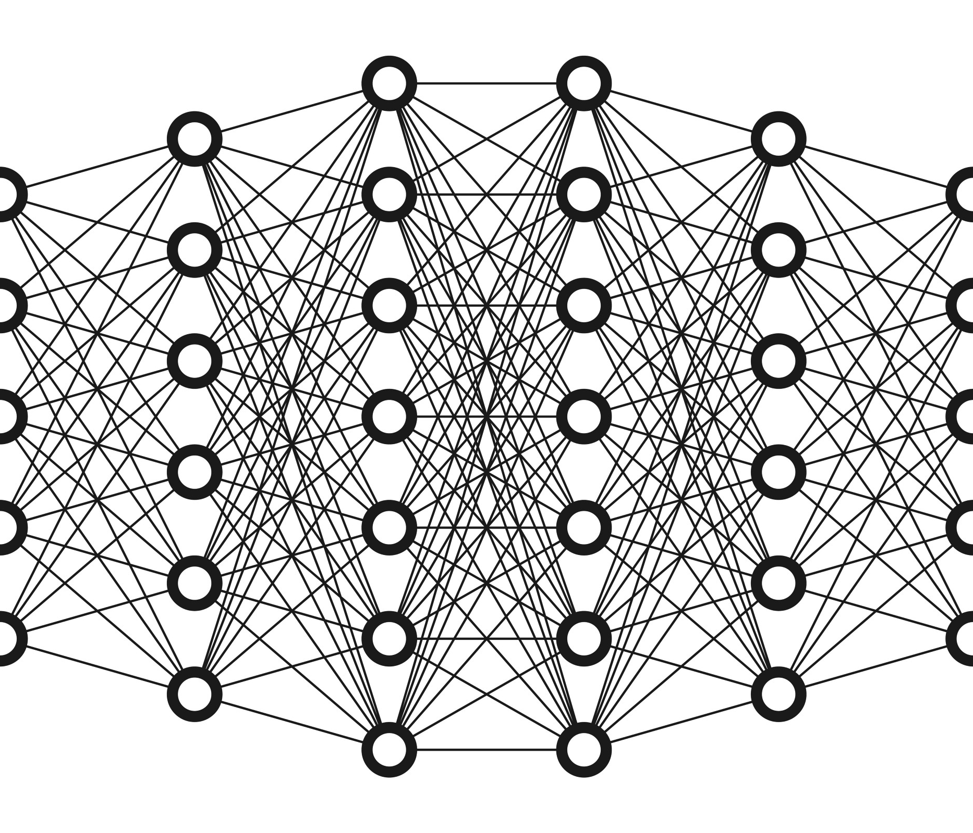
RECAP
In Previous Presentation we have shown how to detect and recognize a object from a video stream using Deep Learning Aproaches
FRAME EXTRACTION
MACHINE LEARNING
DEEP LEARNING & CONVOLUTION NEURAL NETWORKS(CNN)
POOLING
SSD IMPLEMENTATION
TRAINING OF DATASET COCO
& MODEL CAFFE
EXTENSION : CAR LICENSE PLATE DETECTION

Slide 3
CAR LICENSE PLATE RECOGNITION

Slide 4
DATA FLOW DIAGRAM
END
START
NO,
DISCARD FRAME
DB
VIDEO STREAM
IF VEHICLE
?
CCAFFE
MODEL
YES
FRAME EXTRACTION
LICENSE NO EXTRACTION
CNN & SSD TO DETECT CARS, BUSES, MOTORBIKE
END

Slide 5
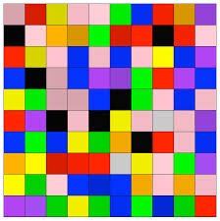


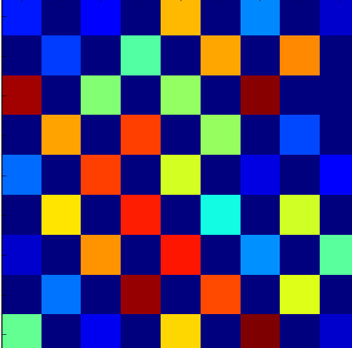
FRAME EXTRACTION : RECAP

Slide 6
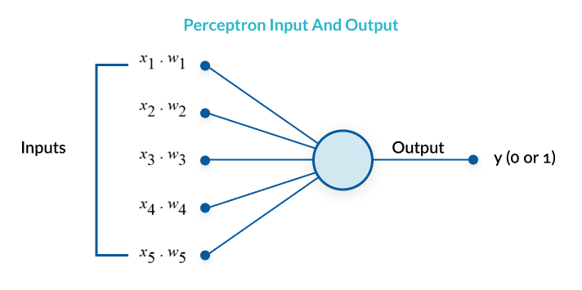
bASICS OF nEURAL NETWORK

Slide 7




HEY , I CAN UNDERSTAND COLOURS, WILL YOU HELP ME IN SHAPES ?
HEY , I CAN UNDERSTAND SHAPES BUT I AM COLOUR BLIND

Slide 8

CNN ARCHITECTURE
CONVOLUTION LAYERS
RELU LAYER/tanH/sigmoid
POOLING LAYER

Slide 9
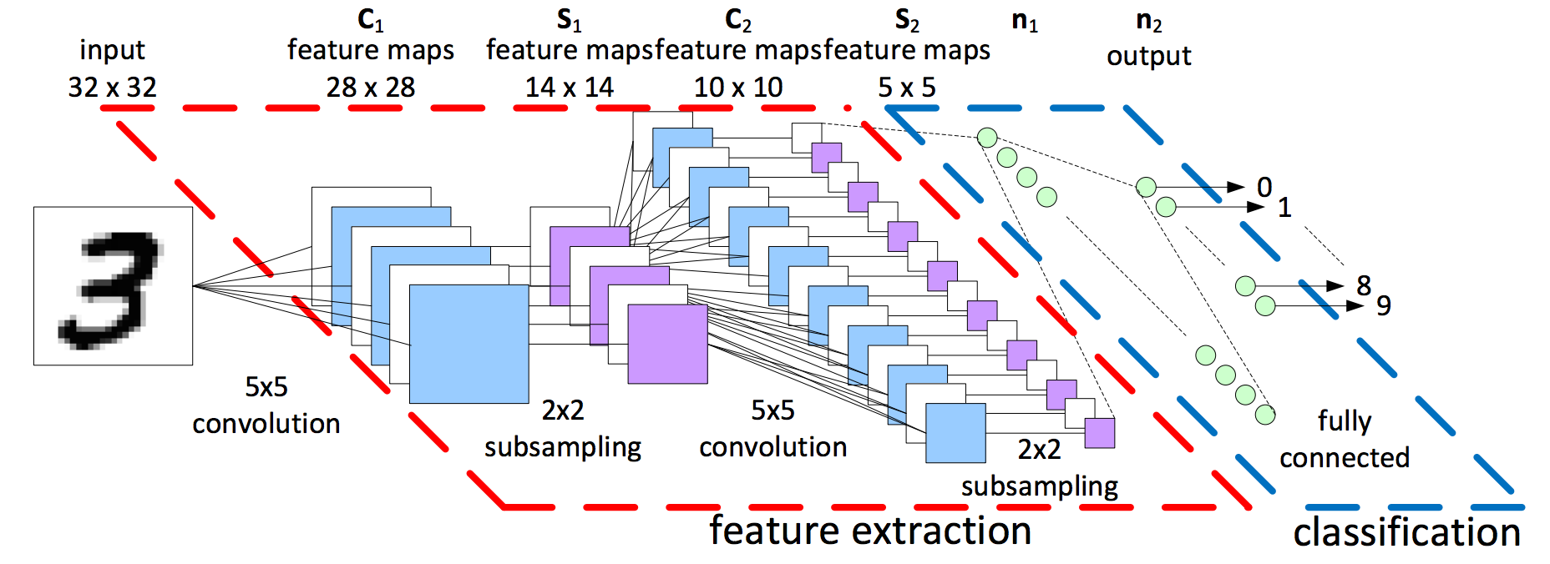
CNN ARCHITECTURE

Slide 10
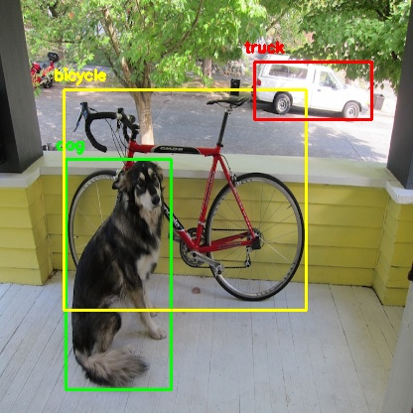
Single Shot Detector(SSD) MULTIBOX
Single Shot : This means that tasks of object localization and classification are done in a single forward pass of the network
Multibox: To detect object of different aspect ratio (developed by Szegedy)
Detector: The network is object detector that also classifies those objects.

Slide 11
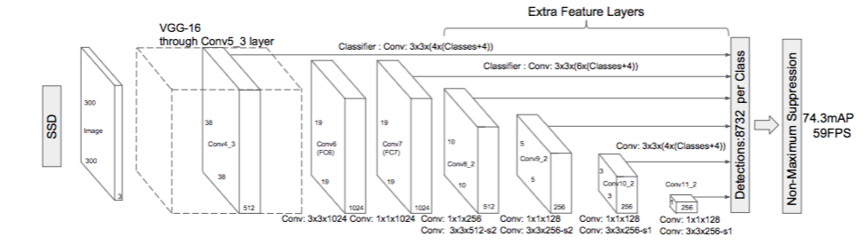
SSD ARCHITECTURE

Slide 12
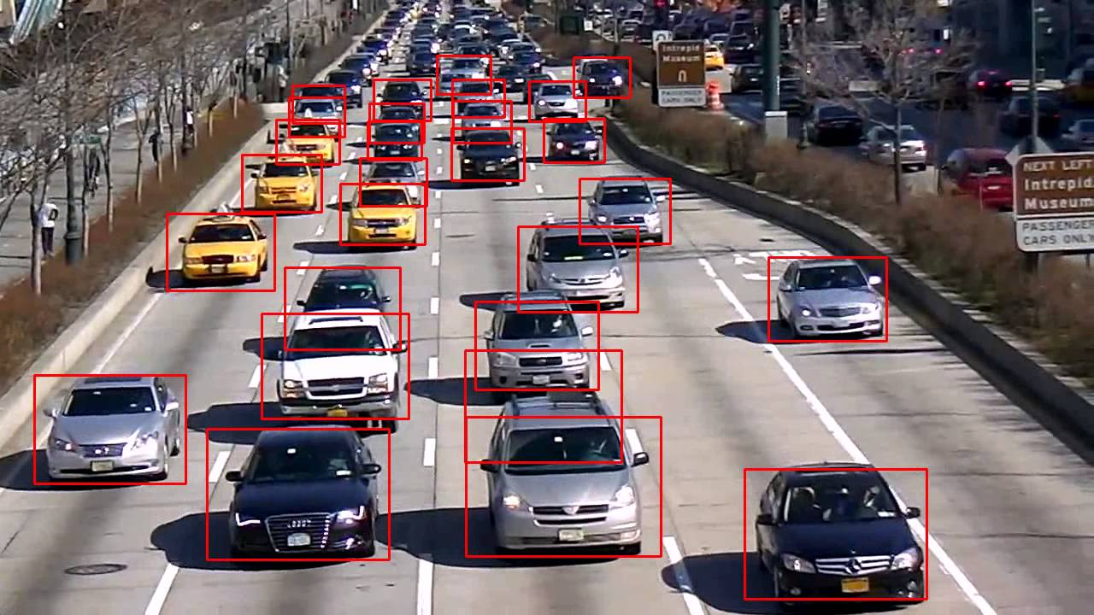
CAR DETCTION & PIPELINING
The bounding box detected as any of the vehicle class ( i.e car, bus, motorcycle) is passed as input parameter for Number plate detction

Slide 13
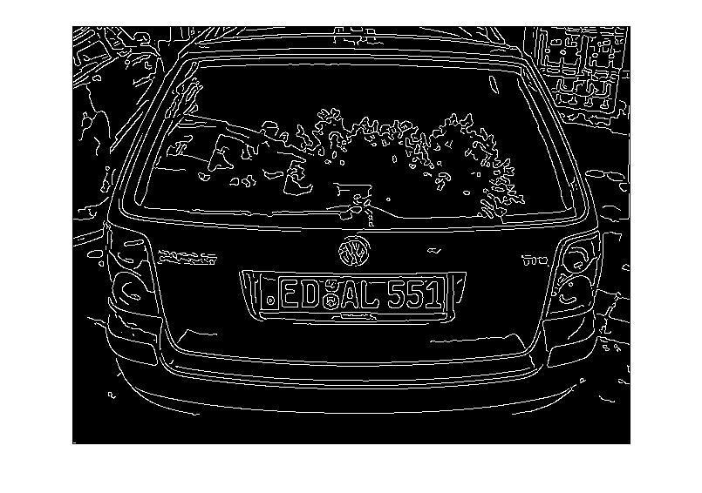

NUMBER PLATE DETECTION : EDGE HIGHLIGHTING
Detect a Box within the the input bounding box region
Do Edge Highlighting / Enhancement : using Sobel's Operator
[

Slide 14
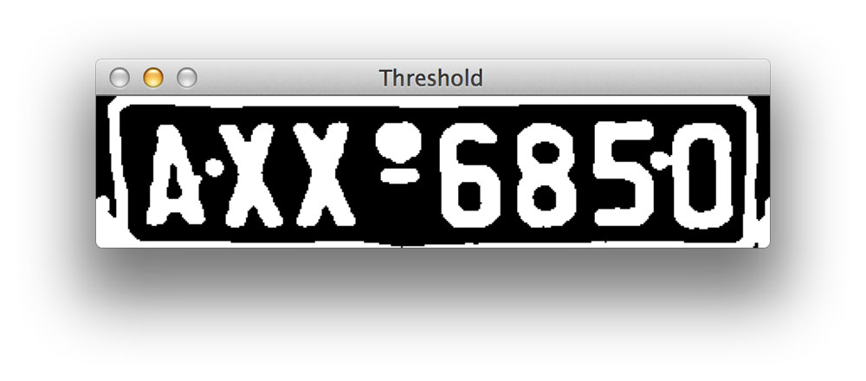
IMAGE SEGMENTATION
Using Region Growing technique
Consider : Seed Pixel at regular interval
No of Seed Pixel : Depending upon the length of license number in the region : IN or US or EU

Slide 15

OPTICAL CHARACTER RECOGNITION
Also uses Convolution Neural Network
We have uses Predefinned Framework : PyTressaract
DATABASE USED FOR RECORD THE ENTRY OF CAR : MYSQL

Slide 16
SKIPPING FRAME & TRADE OFF
High no. of skipped frames
Low no. of skipped frames
More than one entry is made for a single car entry
Process is fast
Entry of few cars may not be recorded into the database
Process is slow

Slide 17

SOLUTION
Software solution : Use license no as Primary Key
Problem : A car can cross a gateway only once
Hardware Solution : Signaling

Slide 18



Technologies Used

Slide 19
THANK YOU

